Slide 1
CYCLING THROUGH PROBATION:
THE ROCKY ROAD TO COMPLETION

Slide 3
WARUCC, Calgary AB | JUNE 2017

Slide 4
WARUCC, Calgary AB | JUNE 2017

Slide 5
Satisfactory Academic Progress
The Old Way
New Academic Standing Codes and Processes
Getting the Message Out
Strategic Enrolment Impact
Lessons Learned
Welcome!
WARUCC, Calgary AB | JUNE 2017

Slide 6
The start:
Satisfactory Academic Progress

Slide 7
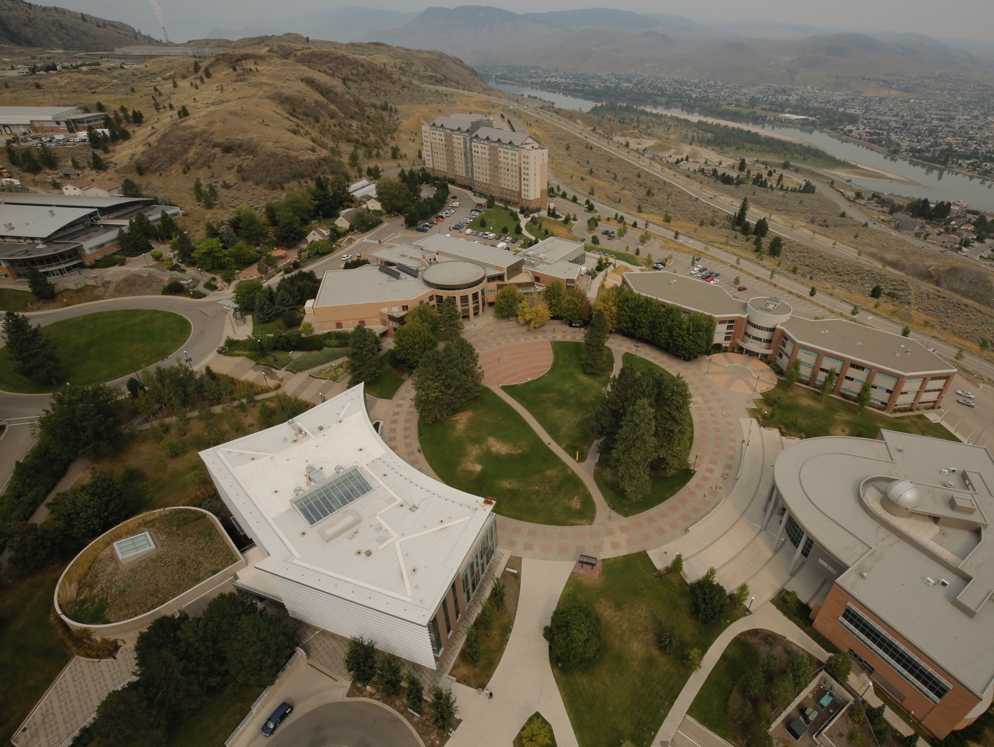
Based on Education Policy ED 3-2:
Run at the end of each term
Identifies Early Alert candidates
Notes Dean’s List achievement
Follows probation and withdrawal rules

Slide 8
What is good academic standing?
Policy
Satisfactory academic progress shall be defined as the achievement of grades which permit a student to move to the next highest level of academic studies.
Academic probation is a warning that progress has not been satisfactory.

Slide 9
What was . . .
The Old Way

Slide 10
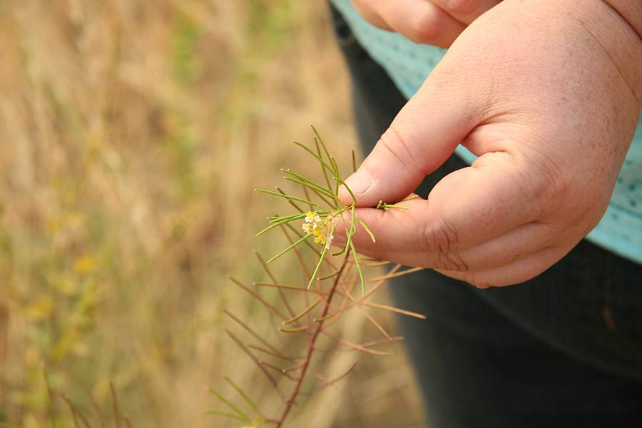
Prior to Fall 2015:
Manual process
Extract of student data was taken for manual evaluation.
Term GPA (UG + UP)
Cum GPA (UG + UP)
Good Standing = tGPA and cumGPA >= 1.50
Probation = tGPA or cumGPA < 1.50
Required to Withdraw = on probation and tGPA and cumGPA < 1.50
Manual intervention
One FTE to manage

Slide 11
Why change process?
Lost the individuals who did this – retirement, moved position
Only need to include UG level
Include all terms include OL
Changed GS from 1.50 to 1.67
Using rules means the rules need to be universal

Slide 12
Revisited Academic Standing Codes
Policy was revised and so results of new policy need to be tracked
Prior to Fall 2015
Fall 2015
Manual process from spreadsheets
Required to withdraw in Jan/May
00 as Good Standing
Term and Cum GPAs
Rules in STVASTD
Only required to withdraw in May
Changed rules each term to match withdrawal rules
Used Unassessed code to move from 00
Cleaned up old codes

Slide 13
Words of Wisdom
“Making the simple complicated is commonplace; making the complicated simple, awesomely simple, that's creativity.”
- Charles Mingus

Slide 14
The New Policy:
New Academic Standing Codes and Procedures

Slide 15
New policy highlights?
cumGPA calculated on all attempted TRU UG courses
cumGPA of 1.67 undergraduate studies
No assessment until after 24 credits
Assessed on an ongoing basis
After attempting an additional 24 credit, and have not shown significant improvement, will be required to withdraw.

Slide 16
Learned at Elive!
Do and Don’t of AS rules
00 should never be used for Good Standing
Academic Standing and Dean’s List run together
Careful consideration to type of hours – attempted, earned, GPA, etc.
To exclude no credit programs, use a minimum of 1 credit to evaluate
Track cyclers

Slide 17
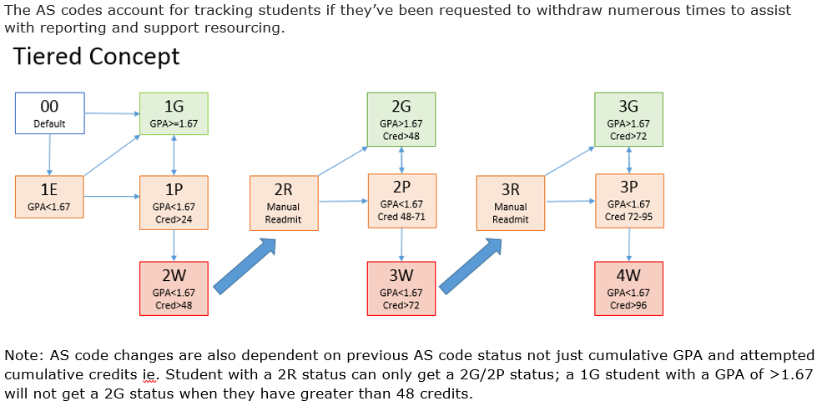
Tracking Student Withdrawals
WARUCC, Calgary AB | JUNE 2017

Slide 18
Revisited Academic Standing Codes
Policy was revised and so results of new policy need to be tracked
Code | Description | Cumulative Credits | Notes
00 | Unassessed |  | Academic Standing rules have not been run on student yet (default system code)
1G | Good Standing |  | GPA >= 1.67
1E | Good Standing (Early Alert) |  | GPA < 1.67
1P | Probation (First) | >= 24 | GPA < 1.67
2W | Required to Withdraw (First) | >= 48 | 1P status and GPA < 1.67 * student required to take a year off
2R* | Probation (First Return from Probation) |  | 2W status and student contacts admissions after a year who manually updates code to 2R and readmits
2G | Good Standing | >48 | 2R status and >= 1.67 GPA
2P | Probation (Second) | 48-71 | Previous 2W and/or 2R status < 1.67 GPA
3W | Required to Withdraw (Second) | >72 | 2P or 2R status <1.67 GPA *student required to take a year off
3R* | Probation (Second Return from Probation) |  | 3W status and student contacts admissions after a year who manually updates code to 3R and readmits
3G | Good Standing | >72 | 3R status and >=1.67 GPA
3P | Probation (Third) | 72-95 | Previous 3W or 3R status and <1.67 GPA
4W | Required to Withdraw (Third) | >96 | 3P status and <1.67 GPA *student required to take a year off
Fall 2016
Revised rules in STVASTD
Early Alert introduced
Cycles through GS, PB, Withdraw, Reenter
Rules on cumGPA

Slide 19
Banner Process
Check for missing grades
Run SHRROLL and Include/Exclude -- daily batch at TRU
Run SHRASTD in POST, export results to Excel to verify AS code changes/rules
In PROD, run SHRASTD and export results
Run Grade Mailer SHRAGRDE to lock in grades for that term so consecutive AS rules don’t update them

Slide 20
Reporting:
Getting the Message Out

Slide 21
Share . . .
“More information is always better than less. When people know the reason things are happening, even if it's bad news, they can adjust their expectations and react accordingly. Keeping people in the dark only serves to stir negative emotions.”
- Simon Sinek

Slide 22
Reports and Checking
Argos Reports, Messaging, tips for Excel

Slide 23
What to look out for . . .
Perform an Audit in SHRASTD and export the log into Excel. Highlight the changes column and create a pivot table with a count on the changes to verify the AS rules are working correctly
Can also filter the Excel export on the changes to spot check the changes the students had using SHATERM and SHAINST (and drop-down Term -> Term Summary SHQTERM)
At TRU, if a student took UG courses in previous term, and then UP/GR courses only in this term, it will carry over the previous terms AS code and look like a change has occurred.

Slide 24
Reports to track AS and DL
SR606.0 Academic Standing
This Academic Standing report is used to identify students who require a probationary letter sent out, as well as identify Early Alert students whose GPA is lower than 1.67 that may need referral to campus resources to improve their standing.

Slide 25
Reports con’t
SR602.2 Dean’s List
This report shows students who have successfully completed at least 15 credits during a semester, and who achieve a semester grade point average of 3.50 or better. Dean’s and Department chairs use this report to acknowledge achievements for students in their faculty.

Slide 26
Probationary Status
Communication to Students
In addition to students being able to see their status online in registration status, . . .
Review by Records for any manual overrides needed.
Letter to student sent from Records
Advisor sees student status on Student Advisor Profile

Slide 27
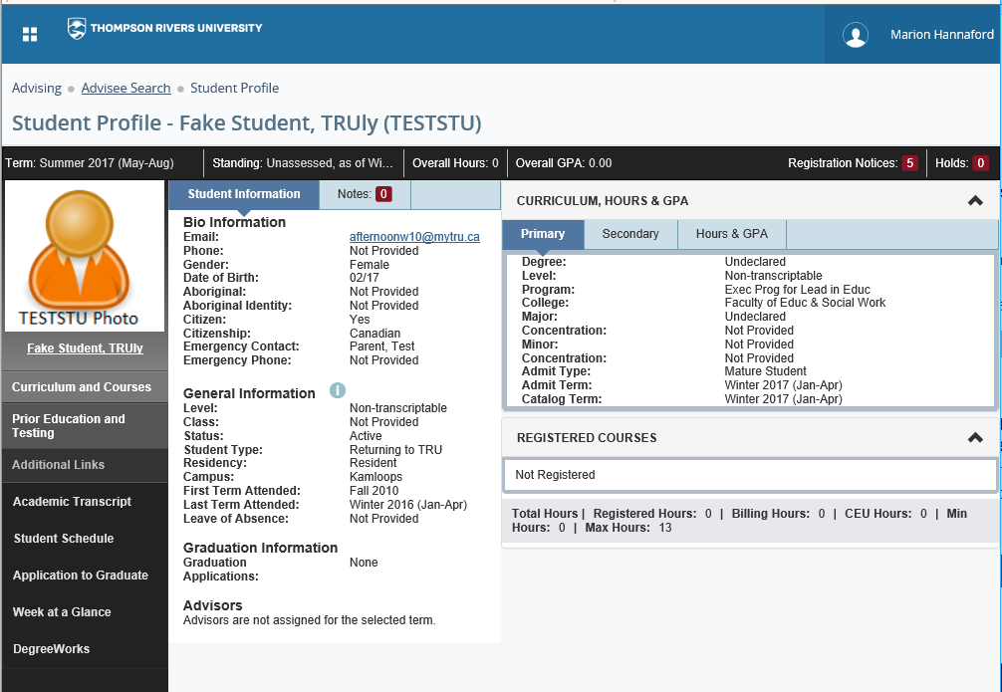

Slide 28
Impact:
Strategic Enrolment Impact

Slide 29
Tracking the cyclists
Through coding, you can see the routes students take
Depending on the depths you want to dive:
Track type or source of students at risk of cycling out
Track frequency of students cycling out and returning
Look for cycling patterns in specific programs
Planning can then be undertaken to provide academic supports, reexamine admission practices/requirements, review curriculum, and evaluate what satisfactory progress is at TRU.

Slide 30
Follow Up:
Lessons Learned

Slide 31
Academic Standing Overrides
When to update SHAINST vs SFAREGS/SGASTDN
SFASTDN/SFAREGS only good for that term
SHAINST change effective until next SHAINST record created
Readmit on the SHAINST records as multiple terms likely open

Slide 32
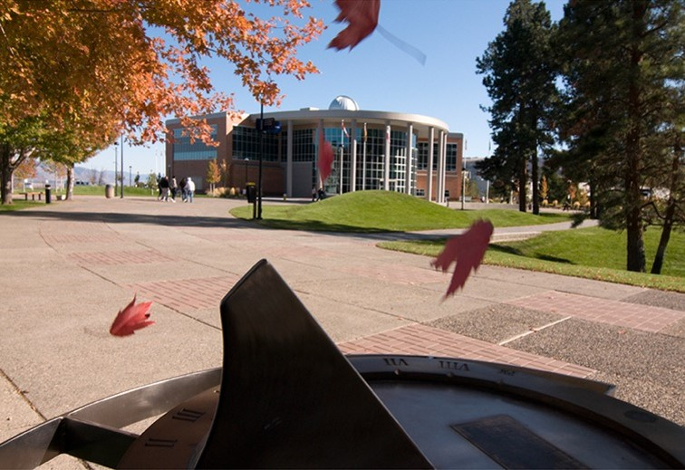
Do transfer and PLAR count:
A question of interpretation
GPA
Number of credits
Some grades don’t impact GPA: NCG, no credit granted; COM, complete; S, Plar credit; TR, transfer credit; AEG, Aegrotat.
Not all courses have credits, but all credits count towards the credit count
There is a line in the policy to say that they can remain on probation if they are making improvements. But that is a human call. Make sure it is done though.
Back to the policy:
Satisfactory academic progress shall be defined as the achievement of grades which permit a student to move to the next highest level of academic studies.
Academic probation is a warning that progress has not been satisfactory
^{Navigating to a credential}

Slide 33
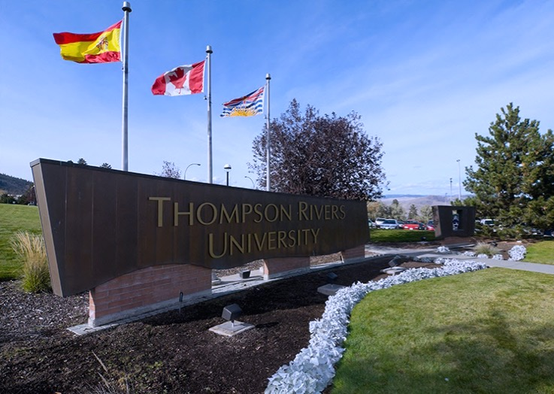
Early Intervention:
Formal and Informal
^{Early Alerts}
^{Advisors}
^{Faculty}
^{Student Affairs}
^{Admissions and Records Staff}
^{Whole institution effort}

Slide 34
On the bright side
And there is one
Engagement from across the institution
Early Alerts are in place
Dean’s are connecting with Dean’s List students
Process can be done in a couple of days rather than three weeks +
After one year, there are fewer students being required to withdraw as long as the improving but not there yet consideration is given.

Slide 35
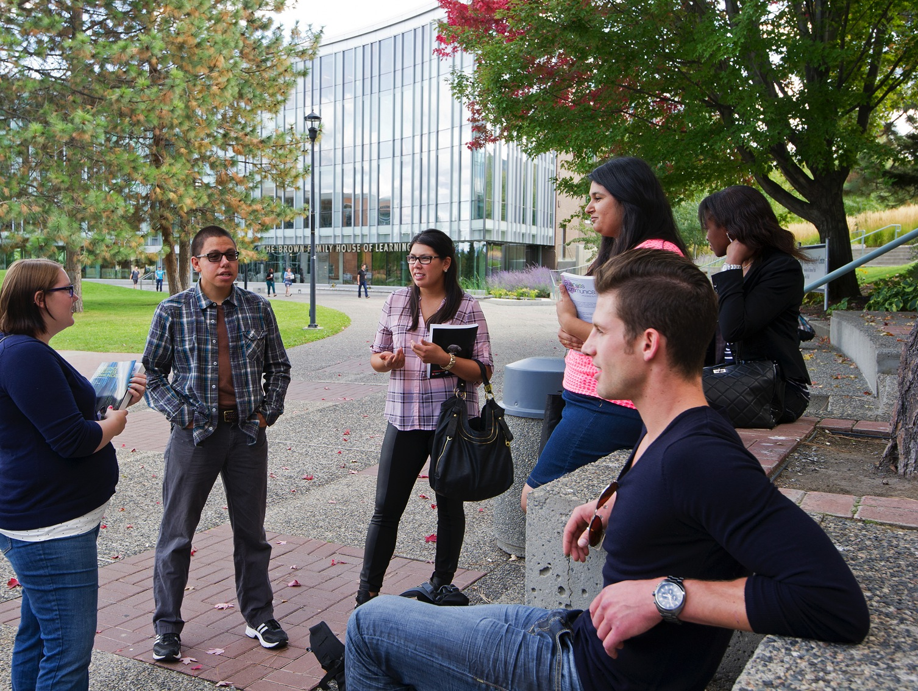
Other resources
TRU Website links:
Early Alert - https://www.tru.ca/campus/services/support/early-alert.html
Academic Standing and Probation - https://www.tru.ca/campus/current/academic-records/academic-probation.html
GPA Overview - https://www.tru.ca/campus/current/academic-records/gpa.html

Slide 36
Questions & Discussion

Slide 37
Marion Hannaford
Associate Registrar, Systems & Reporting
Thompson Rivers University,
Kamloops, BC, Canada
mhannaford@tru.ca
Thank You!

